Slide 1
Finish the Prototype
Mack 2023

Slide 2
Learning Objectives
Students will learn how to create a variable to store the score in a game script.
Students will understand how to detect when the player has collected a coin.
Students will be able to set up a score text to display the score during gameplay.
Students will learn how to set up an end flag to trigger a change in the game.

Slide 3
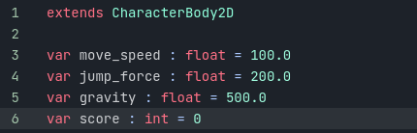
Creating the Score Variable
The first step is to create a variable to store the score in our Player.gd script.
We will call this variable score, it will be of type int and give it a default value of 0. This can be placed below the last gravity variable.

Slide 4

Creating the Score Variable
We can then create an add_score function that will take a parameter named amount. This can be placed below our game_over function.
We will then use this function to add the amount value to our score variable. This will not be everything in the function, however, this will be the base functionality for now.

Slide 5
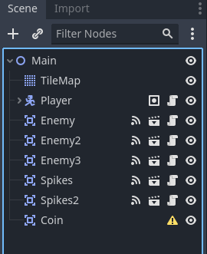
Creating the Coin Node
Like with our Enemy and Spike scenes, we will begin by creating an Area2D node and naming it Coin.

Slide 6
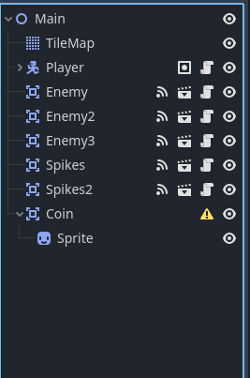
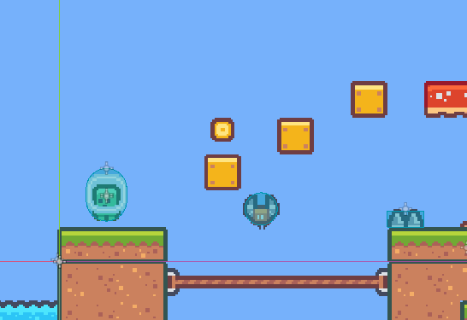
Creating the Coin Node
From the Sprites folder, drag in a sprite to use for our coin. From our sprite pack, we will be using a sprite named tile_0151.png. Make the sprite a child of Coin and rename it to Sprite.

Slide 7
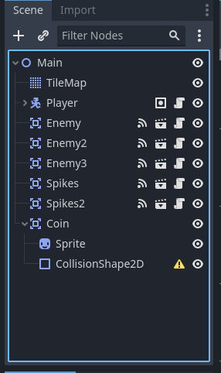
Creating the Coin Node
Create a CollisionShape2D as a child node of Coin.

Slide 8
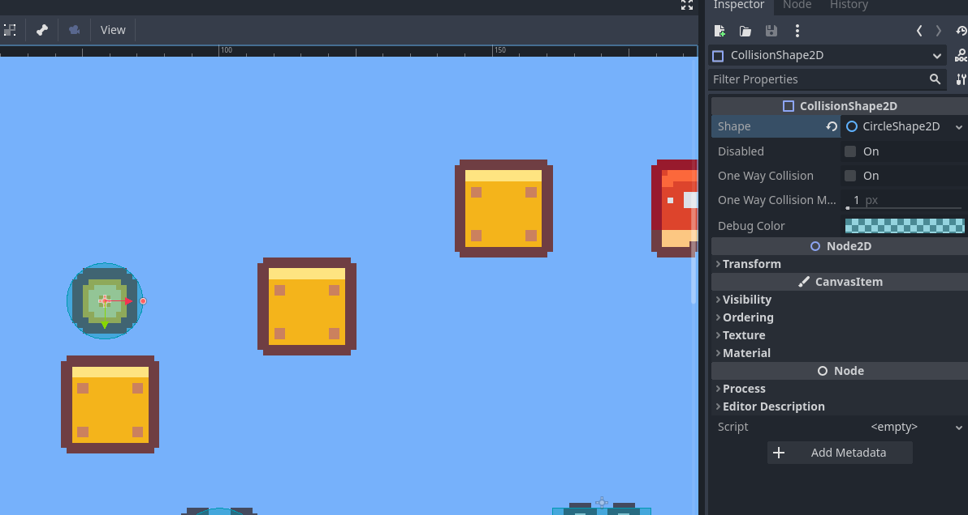
Creating the Coin Node
Then create a new CircleShape2D for the Shape property and resize it to the Coin sprite.

Slide 9
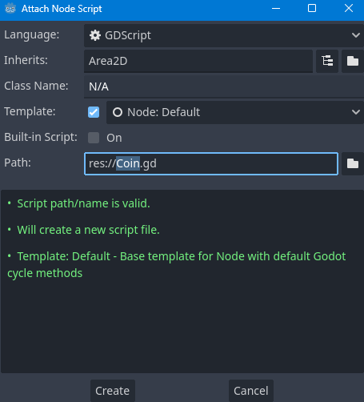
Adding Movement to the Coin
We want the coin to move up and down. To do this we will create a New Script on our Coin node,making sure to name it Coin.gd.

Slide 10
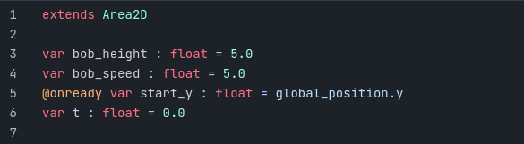
Adding Movement to the Coin
Firstly, you can remove the _ready function as we won’t be needing it in this script. From here, we need to create some variables:
Notes:
bob_height – This will show how many pixels our coin will move up and down. In this case, we use a default value of 5.0.
bob_speed – This will be the speed at which our coin bobs up and down.
start_y – This will keep track of our starting y position. To set it when the script begins running, we use the @onready tag. This will then allow us to use the global_position value, as using the @onready tag is like setting something in the _ready function.
t – This will be the time value, a number that we will increase every frame.

Slide 11
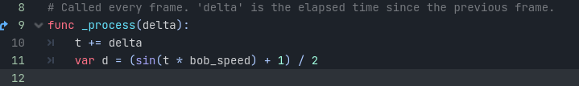
Adding Movement to the Coin
Now, inside of _process we are ready to write the functionality for our coin movement. We will begin by increasing t by delta to keep track of the time that has passed. We can then pass the t value into a sin function which will give us a value along a sin wave between 1 and 0. We will save this in a variable called d for sin delta.

Slide 12
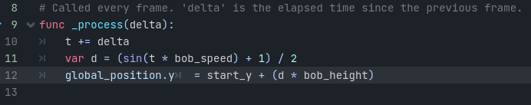
Adding Movement to the Coin
This equation will move along a sign wave at a rate of t multiplied by bob_speed and then we add 1, then divide by 2 to turn the values between -1 and 1 into values between 0 and 1.
From here we can then add the line:
Notes:
This will set the y position of the coin to be increased by the sin delta multiplied by the bob_height. So when the sin delta (d) returns 0 it will be at the start_y position, and when it returns 1 it will be at the maximum position set by bob_height.
Now if you save the script (CTRL+S) and press play you will be able to see the coin bob up and down as intended. All of the variables can of course be edited to change factors like the height and the speed of the bobbing.

Slide 13
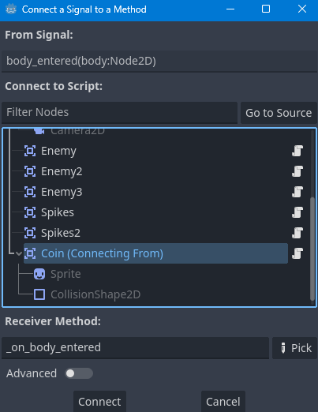
Collecting the Coin
Finally, we need to add code to detect when the player has collected the coin. Like with the Enemy, we will do this by connecting a body_entered signal from the Signals section under the Node tab.
This can then be connected to the Coin node and press Connect.

Slide 14
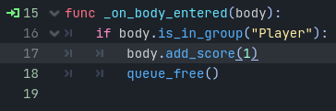
Collecting the Coin
Then, in the Coin.gd script we want to add the following code to the new _on_body_entered function.
Notes:
This will check if the body collided with our Player node, and if it is, call the add_score function with a value of 1. Then we will use the queue_free function to destroy the coin node after it has been collected.
Now you can save the script and press Play and you will be able to collect the coin.

Slide 15
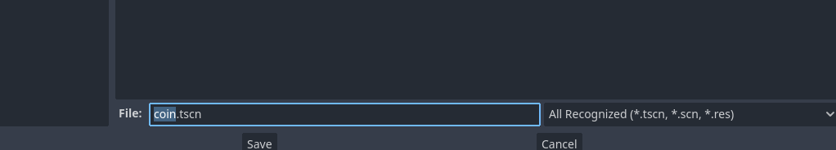
Creating a Scene from the Coin Node
We finally need to create a scene from the Coin node, so that we can have multiple instances of this. Do this by dragging the Coin node into the FileSystem tab.
Notes:
From here, this can be named Coin.tscn and Saved. You can now use this scene to create coins across your level for the player to collect and increase their score.

Slide 16
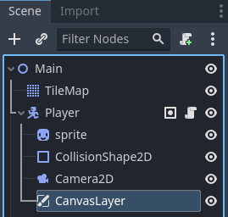
Creating the Score Text
First, we need to create a Canvas Layer as a child node of the Player node, this is a node that renders UI elements on our screen. We will also add a Label node as a child to the Canvas Layer.

Slide 17
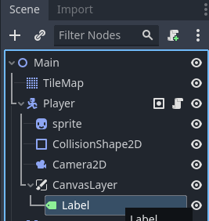
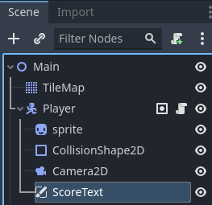
Creating the Score Text
We can then rename the label to ScoreText.

Slide 18
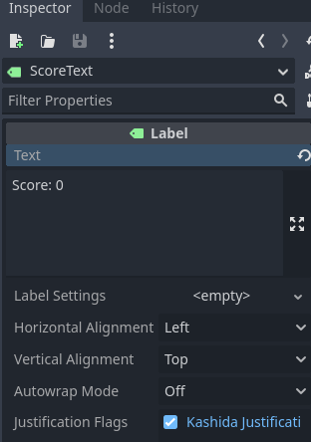
Creating the Score Text
Next, select the ScoreText node and press the F key to focus on it. In the inspector, add the text Score: 0. This will be the text that is displayed on the screen.

Slide 19
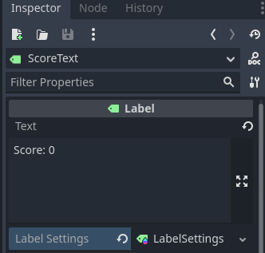
Creating the Score Text
We can position the Score Text wherever we want relative to the screen. To do this, scroll out and you will see a faint blue rectangle. This represents the screen resolution. We can then use the move tool arrows to position it in the space.
We can also customize the Score Text by changing the font size, outline, and shadow. To do this, in this Inspector choose New LabelSettings in the Label Settings property.

Slide 20
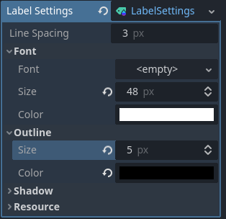
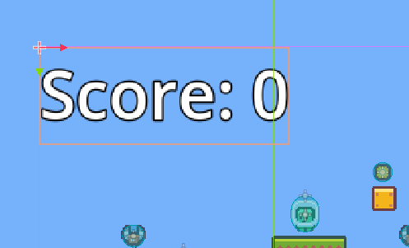
Creating the Score Text
We will increase the font size to 40 pixels and add a black outline that is 5 pixels wide. You can change any of the values you like to your own taste of course.
Notes:
This will make the Score Text display on our screen, however, we still haven’t added any functionality to it.

Slide 21
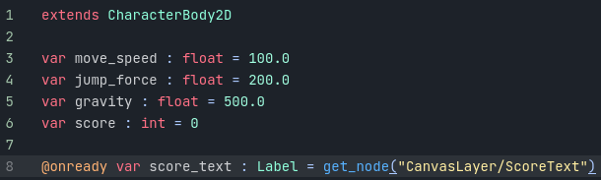
Adding the Score Text to the Script
Now, we need to add the score text to our Player.gd script and hook it up to the function we created previously.
Underneath the score variable, we will add a new variable to keep track of our Score Text. We will use the @onready tag and the get_node function to set it to our Score Text node when the script is loaded.

Slide 22

Adding the Score Text to the Script
Finally, in the add_score function, we want to update our score_text. We will use the str function to combine our integer score variable with a string.
Notes:
Now you can press Play and collect the coins in your level and you will see the score increase. Feel free to duplicate the coin (or drag the Coin.tscn scene into the level from the FileSystem) to create more coins across your level. Due to the way we handle the game_over state of the game, when we restart the score will also be reset as intended.

Slide 23
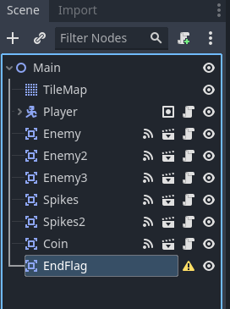
End Flag
To begin with, we will create a new Area2D node, as we have previously, and rename it to EndFlag.

Slide 24
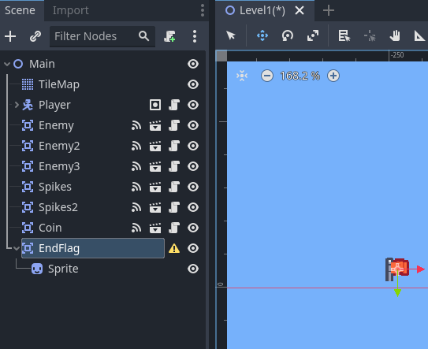
End Flag
We will then add a sprite from the FileSystem, in our case, we will use the tile_0112.png sprite from our asset pack. Finally, make it a child of the EndFlag node and rename it to Sprite.

Slide 25
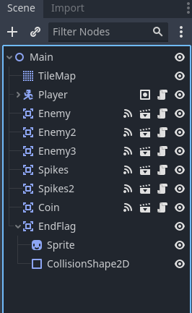
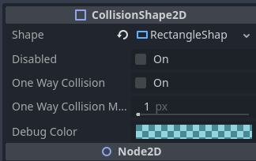
End Flag
Next, add a CollisionShape2D node as a child of our EndFlag. This can then be a New RectangleShape2D for the Shape property, and make sure to scale the collider to the size of your sprite.

Slide 26
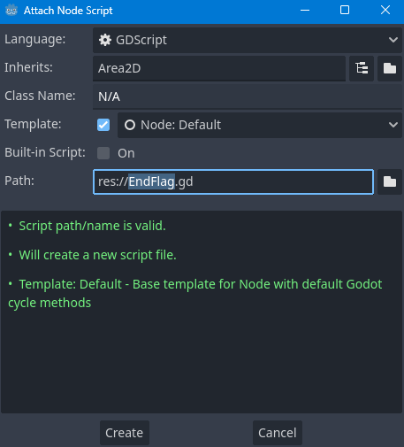

Creating the Script
Next, select the End Flag node and create a new script. Call it EndFlag.gd and make sure it extends from area2d.

Slide 27
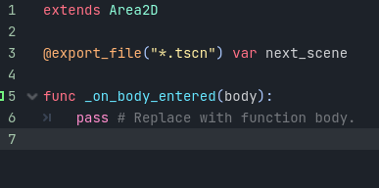
Creating the Script
Under the Node tab, we can then add a body_entered signal to our EndFlag node, like with previous nodes.
Then, create a variable with the @export_file tag of type with the “*.tscn” modifier. We will then call this next_scene to show it stores the next scene.

Slide 28
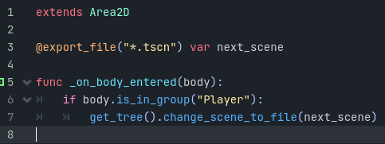
Creating the Script
In the _on_body_entered function, we will then add the code to get the tree and change the scene to the file stored in the variable, after checking whether the collided body is the player node.

Slide 29
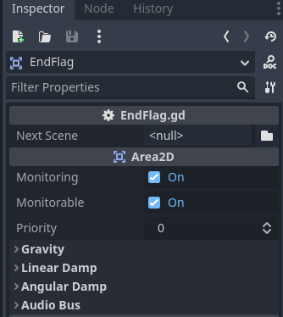
Creating the Script
Now, return to the 2D scene view and you will find the Next Scene property is set to null.

Slide 30
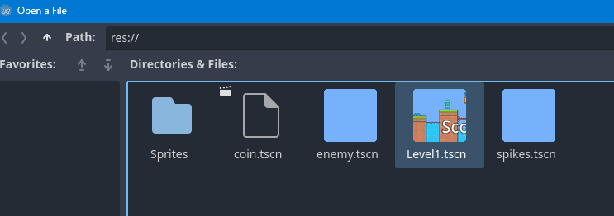
Creating the Script
We now need to create a new scene so that we can set this value. To test the EndFlag we will set the Next Scene property to be our Level1.tscn scene that already exists in the FileSystem.
Notes:
Now if you press Play and let your player character reach the EndFlag node, you will notice the scene restarts, as we load into the Next Scene value, which we set as our Level1.tscn scene.

Slide 31
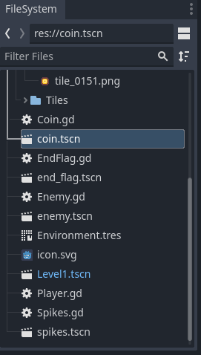
Creating the Script
Finally, we need to drag the EndFlag node into the FileSystem to create a scene out of it, allowing us to have multiple instances of the flag.

Slide 32
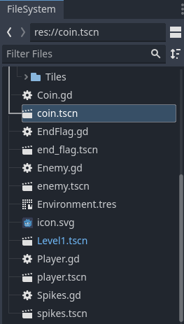
Creating the Script
We also need to turn our Player node into a scene.
Notes:
Having everything as a scene will allow us to construct a new level easily.

Slide 33
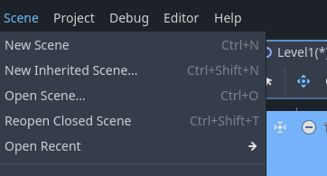
Creating Multiple Scenes
To begin with, press Scene and select New Scene to create a new level.

Slide 34
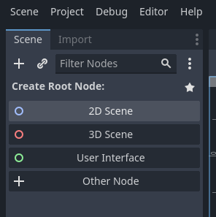
Creating Multiple Scenes
From here select 2D Scene and rename the root node to Main again.

Slide 35
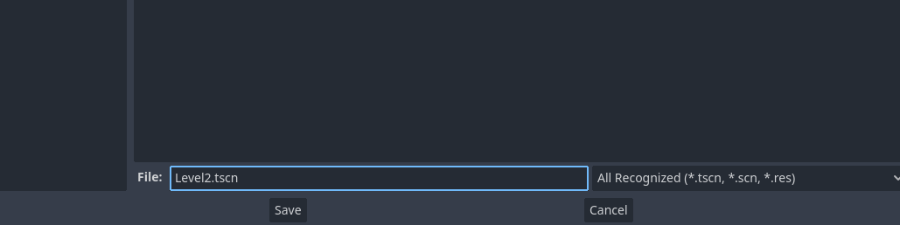
Creating Multiple Scenes
We can now save the scene as Level2.tscn (CTRL+S).

Slide 36
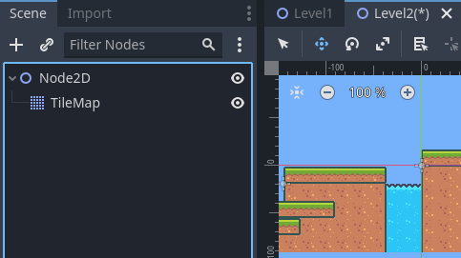
Creating Multiple Scenes
Now return to the Level1 scene tab and copy the TileMap node (CTRL+C).
We can then paste that in the Level2 scene tab and paste the TileMap node (CTRL+V).

Slide 37
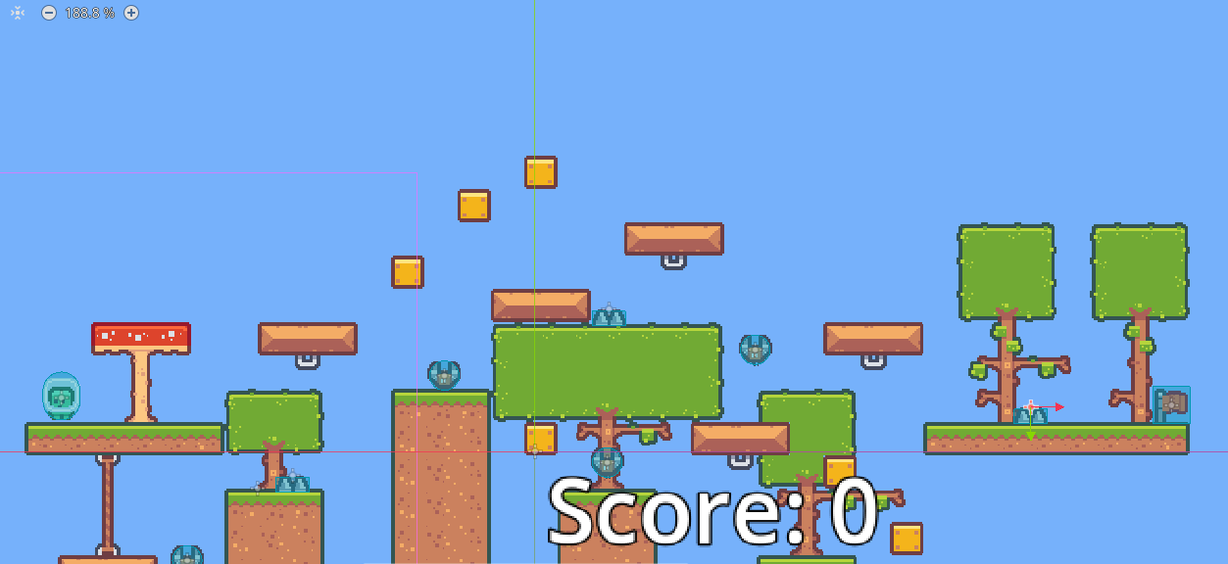
Creating Multiple Scenes
Then using the Select tool to draw on the tilemap, replace the pasted tiles to redraw your TileMap for your new level. This will give us a new map to play on. From here, drag the Player, Enemy, Spikes, Coin, and EndFlag scenes into your level to create some gameplay.

Slide 38

Creating Multiple Scenes
You can press the Run Current Scene (F6) button to test this scene, the normal Play button will simply run the default scene, which is currently set to Level1.

Slide 39
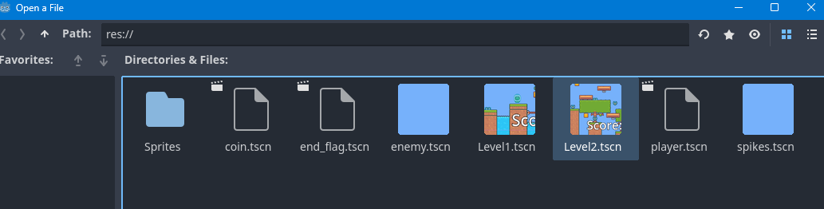
Connecting Level1 to Level2
To connect our levels, we want the EndFlag on Level1 to have a Next Scene property of Level2.tscn.

Slide 40
Connecting Level1 to Level2
Now if you press Play you can touch the EndFlag and you will be teleported to the next level. You now have the skills to set up as many levels as you like and link them together using the EndFlags we set up.

